Slide 1
Chapter 3

Slide 2
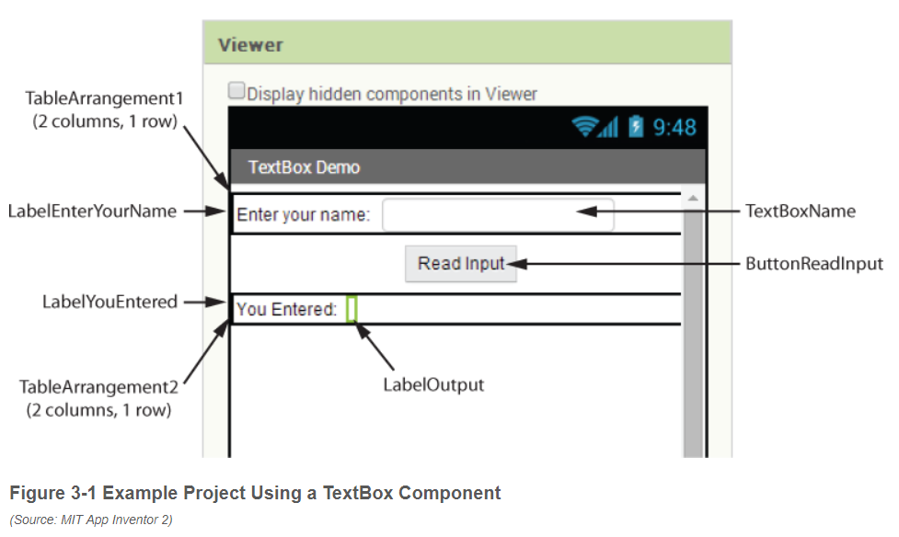
Layout

Slide 3
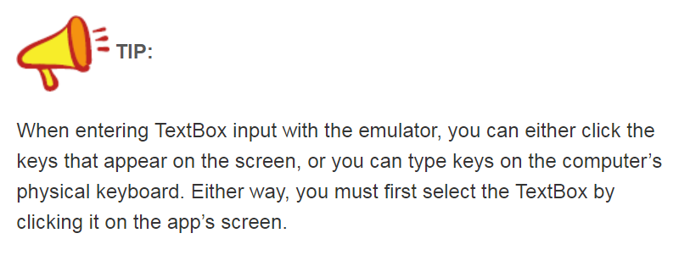
Typing text

Slide 4
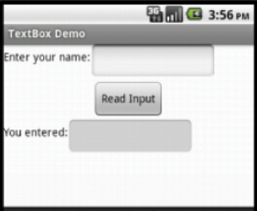
Textbox
The primary purpose of a TextBox component is to get
input from the user. TextBox components can also be used to display
text, however. For example, in the TextBoxDemo app previously
discussed, we might consider using a TextBox component instead of a
Label component to display the user’s name when the button is clicked.
When you are using a TextBox component to
display text (and not to read input), it is a good
idea to uncheck the component’s Enabled property.
That prevents the user from selecting it and entering input into it.

Slide 5
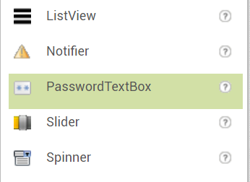
Password textbox
App Inventor also provides a PasswordTextBox component that works just like a regular TextBox, except the characters typed by the user are not displayed.

Slide 6
Question
How do you make sure that the user enters only numbers into a TextBox?
NumbersOnly —If this property is checked, the TextBox will only allow numbers to be entered.

Slide 7
Question
What happens when you uncheck a TextBox component’s Enabled property?
Enabled —If this property is checked in the Properties column, the user is able to enter input into the TextBox. If this property is not checked, the user cannot enter input into the TextBox. When the Enabled property is not checked, the TextBox can be used like a Label to display text.

Slide 8
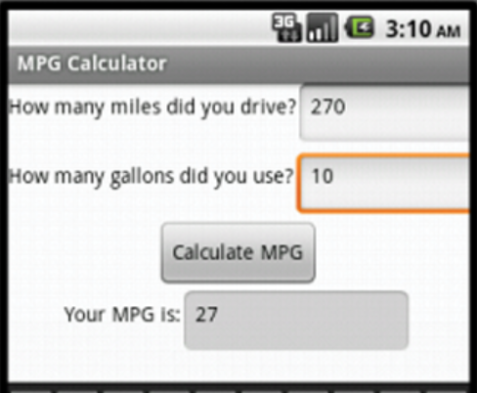
Any Questions on MPG Calculator?

Slide 9
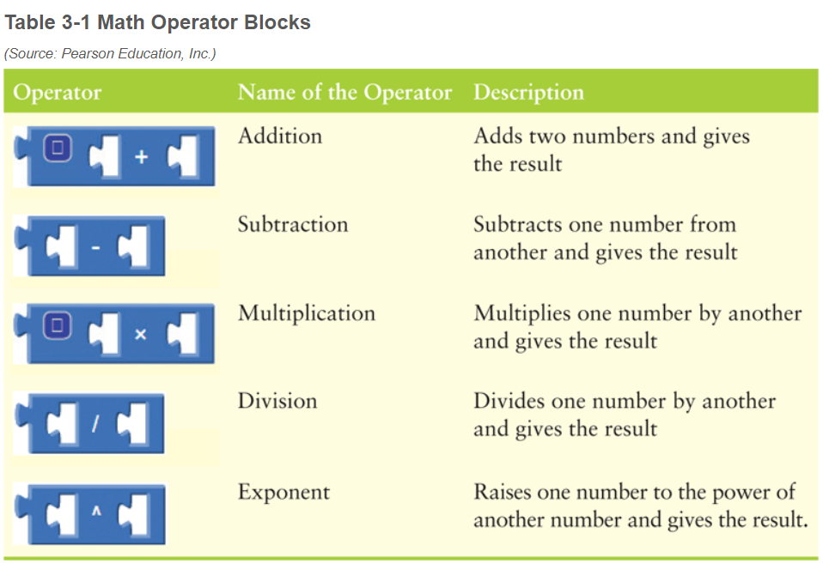
Math Operator Blocks

Slide 10
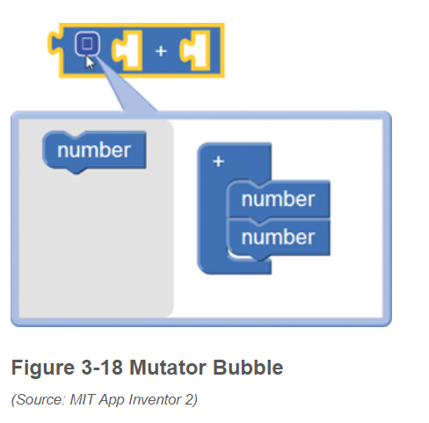
Mutator Blocks

Slide 11
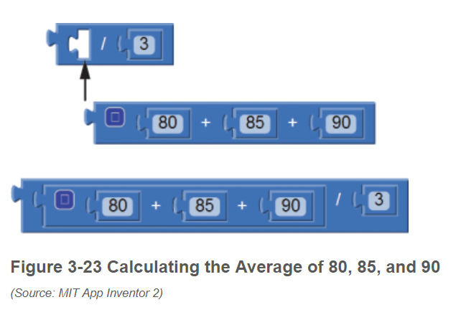
Combining Operator Blocks

Slide 12
Expressions
An expression is simply a clump of code that gives you a value.
You can use math operators to write expressions that perform simple calculations. The result of a math expression can be assigned to a variable.

Slide 13
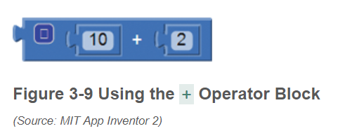
Operands and Expressions
The figure below shows the + operator block with two number blocks plugged in as operands: the number 10 is plugged into the left side, and the number 2 is plugged into the right side. These blocks create a math expression that gives the result of 10 + 2.

Slide 14
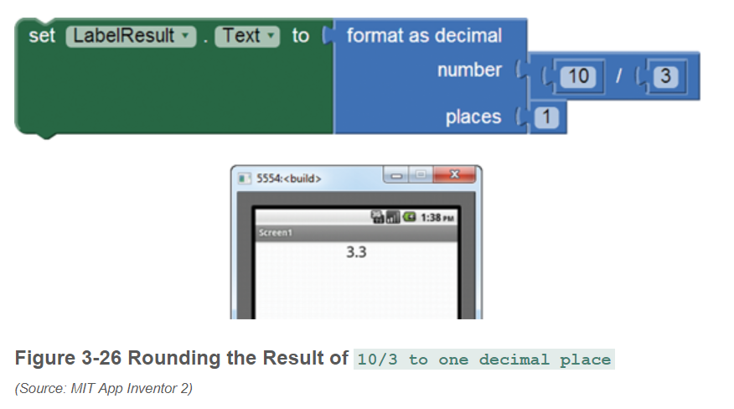
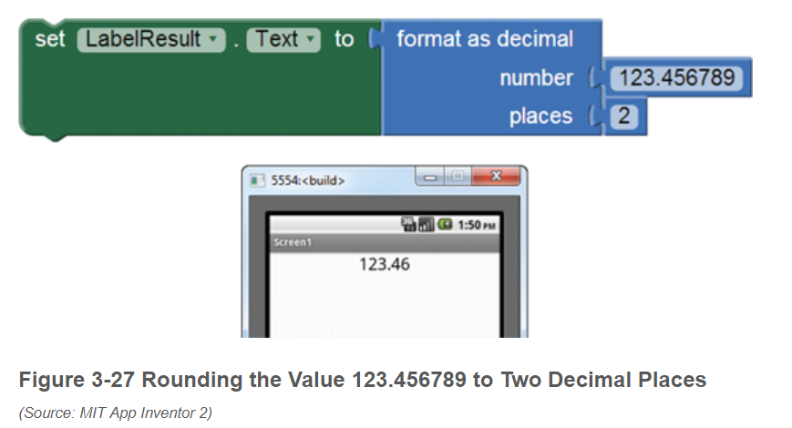
Decimals

Slide 15
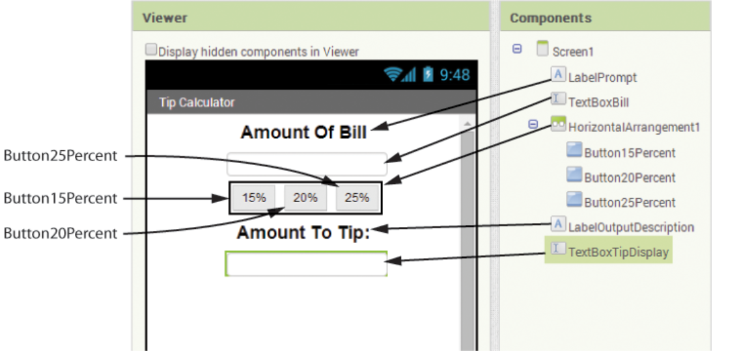
Tip Calculator – Tutorial

Slide 16
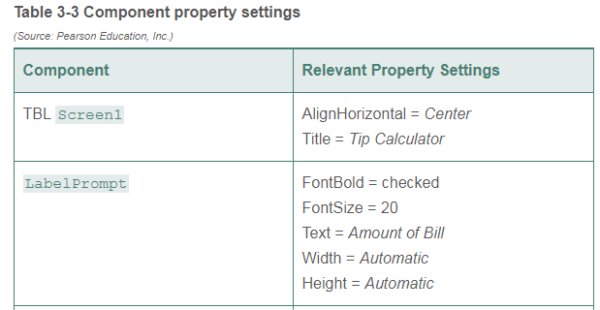
Questions?

Slide 17
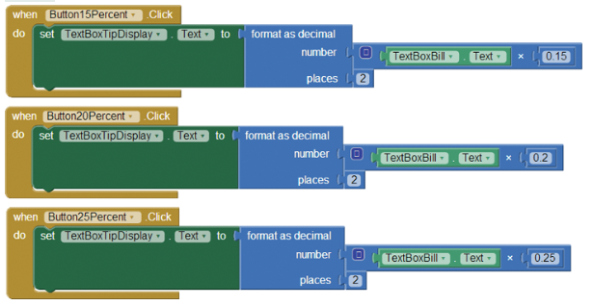
Tip Calculator - Code Blocks

Slide 18
Functions
The format as decimal block is a special type of method known as a
function.
A function is a method that performs an operation and then gives
you a value.
We say that a function returns a value.
When you execute a function (or any type of method), we say that we are calling it.
So when you use the format as decimal block, you can say that you are calling
the format as decimal function.

Slide 19
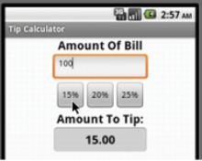
Testing
Always use small or easy to calculate numbers when testing to see if your app is working.

Slide 20
Variables
A variable is a name that represents a value stored in the computer’s memory.
App Inventor allows you to create two types of variables: local and global.
A local variable is created inside a method or function, and it can be accessed only by blocks that are also in that method or function.
A global variable is created outside of all the methods and functions in the workspace, and it can be accessed by any blocks in the workspace, regardless of which method or function they belong to.

Slide 21
Variable Types
number blocks
text string blocks
Boolean blocks (true or false)
List blocks (discussed in Chapter 7)
Color blocks

Slide 22
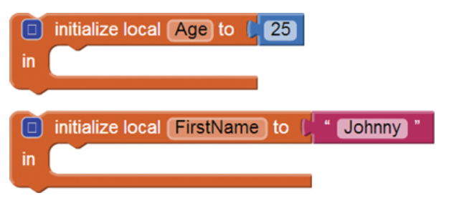
Local Variables
To create a local variable in App Inventor, you must initialize it. This simply means that you are storing a starting value in the variable.
When you create a variable, you must also set the variable’s starting value. When we set a variable to a value, we say that we are assigning a value to the variable.

Slide 23
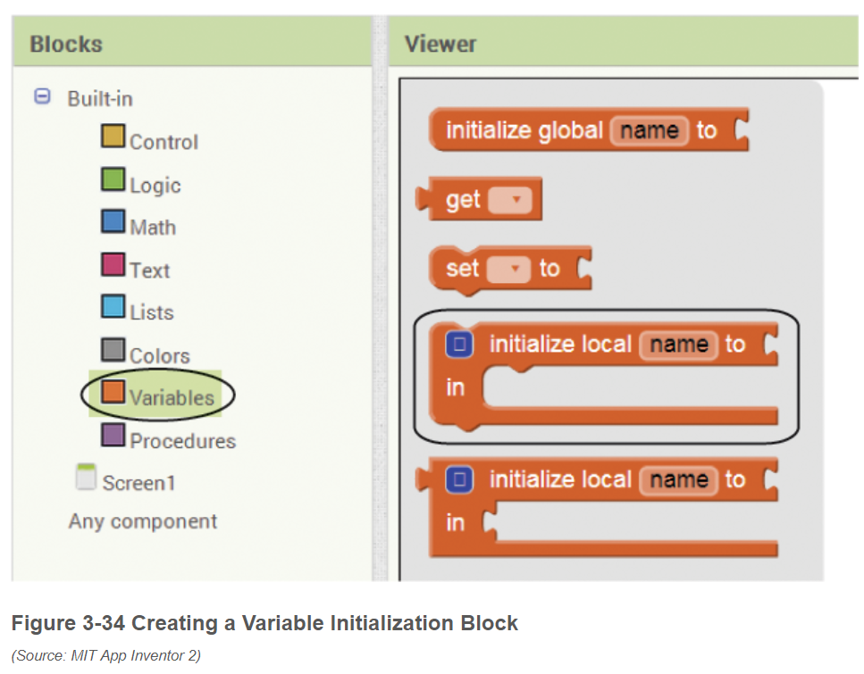
Local Variables

Slide 24
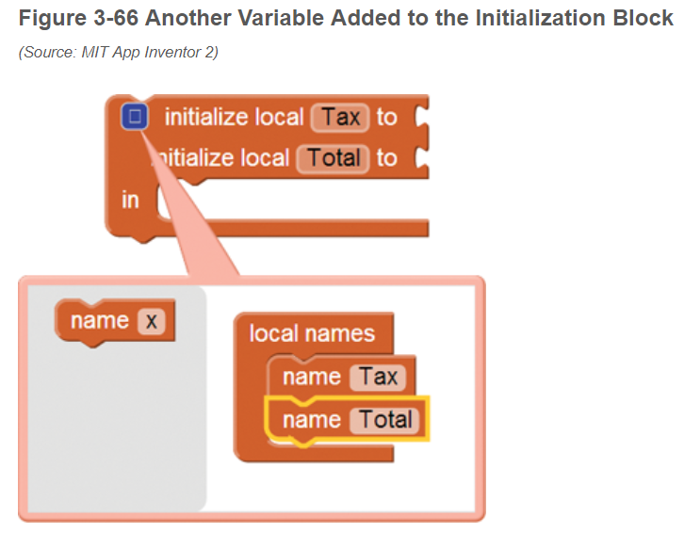
Multiple Local Variables

Slide 25
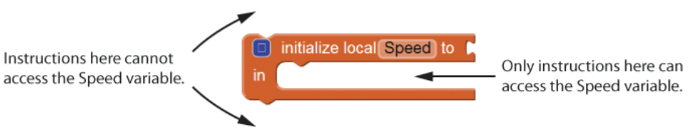
Local Scope

Slide 26
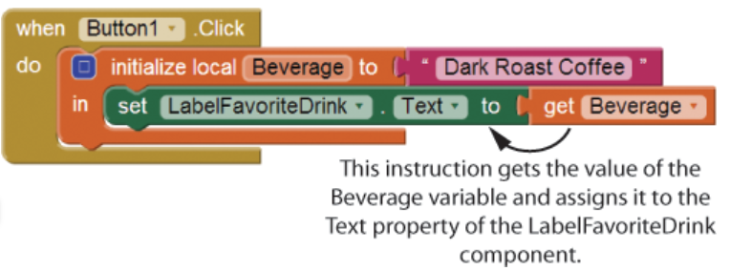
Get Block

Slide 27
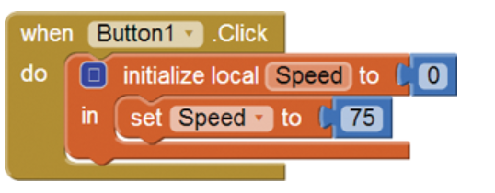
Set Block

Slide 28
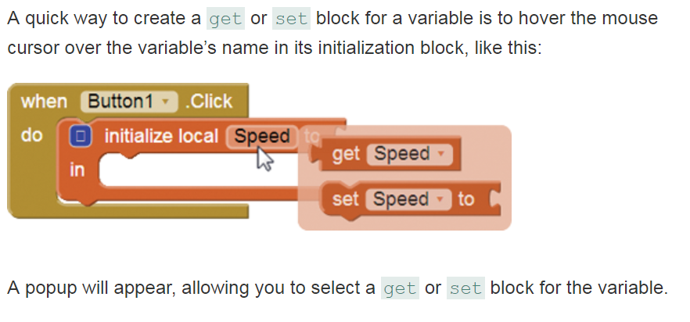
Quick Access to get and set blocks

Slide 29
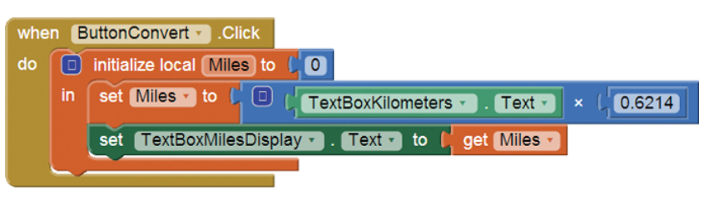
What is happening here?

Slide 30
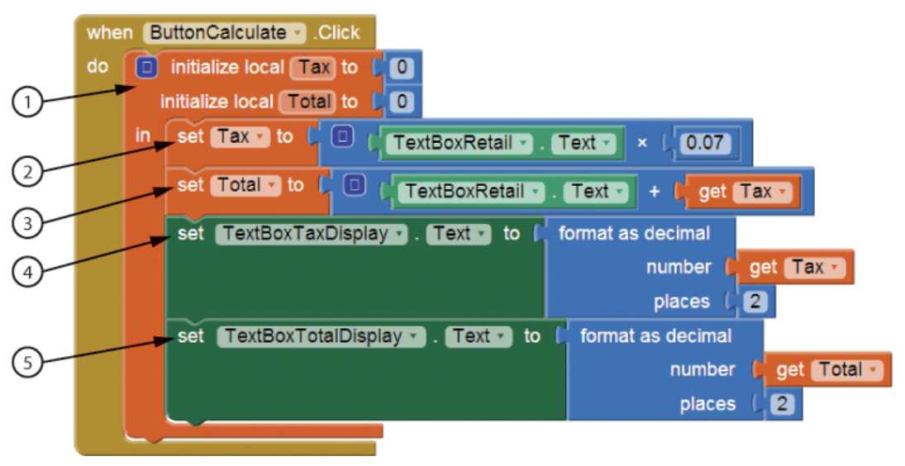
What is happening here?

Slide 31
Global Variables
A global variable is created outside of all methods and functions. The scope of a global variable is the entire workspace, so it is accessible to all of the code in the workspace.

Slide 32
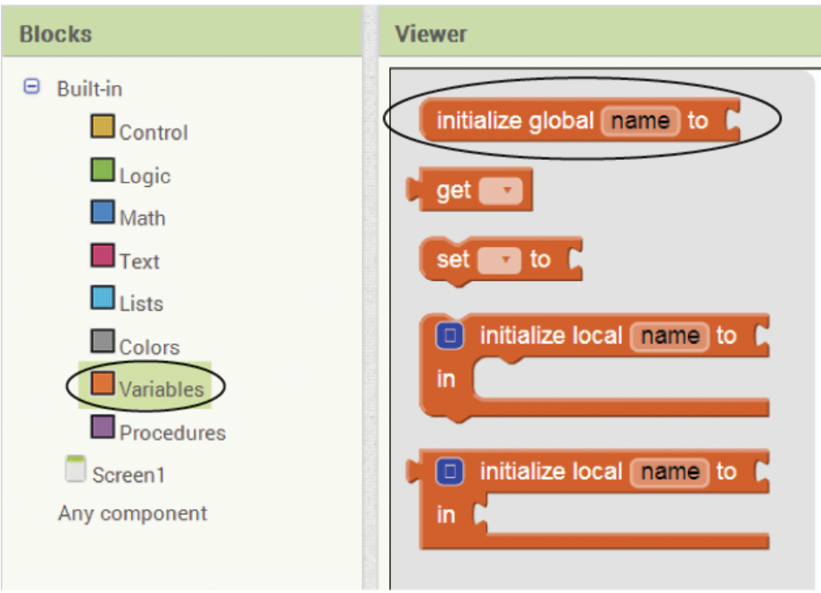
Global Variable Block

Slide 33
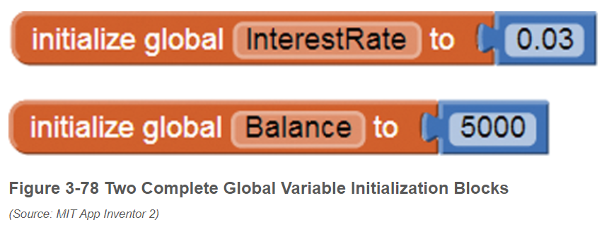
Global Examples

Slide 34
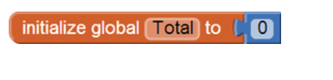
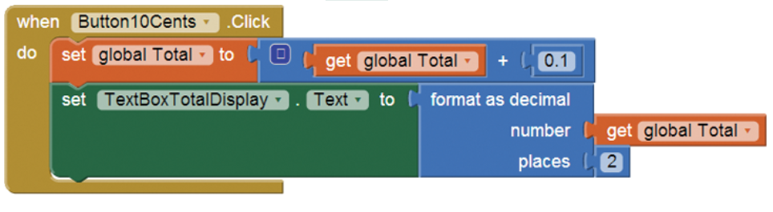
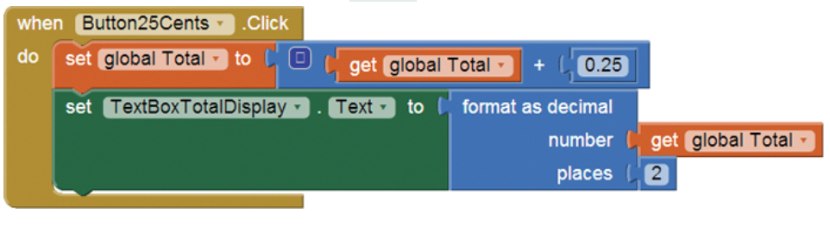
Problem with Global Variables

Slide 35
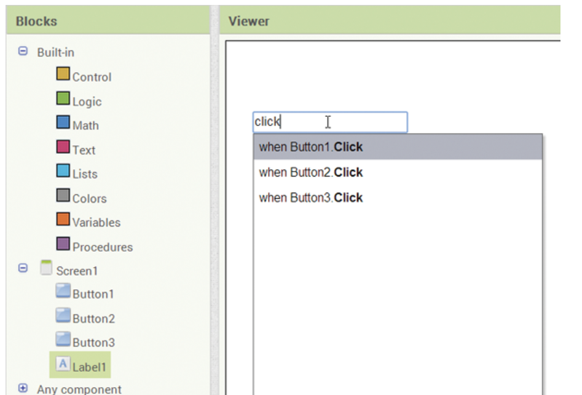
Typeblocking
shortcut method of creating blocks with the keyboard
click anywhere in the workspace and type part of the name of the block that you want to create

Slide 36
Numbers and Text
You can use typeblocking to quickly create number blocks and text string blocks. For example, suppose you want to create a number block with the value 25. Simply click inside the workspace, type 25, and press Enter.

Slide 37
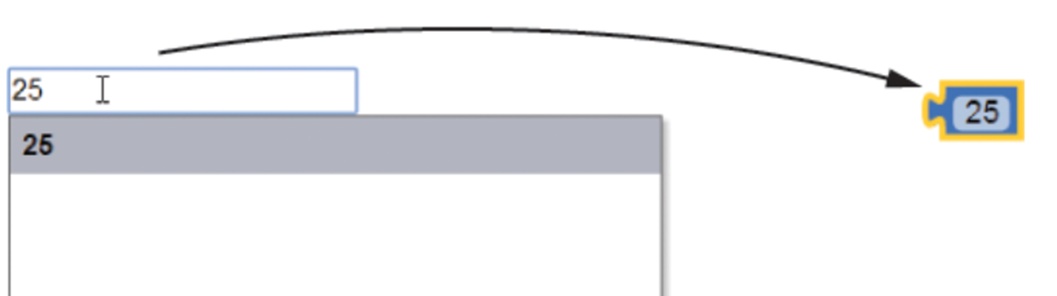
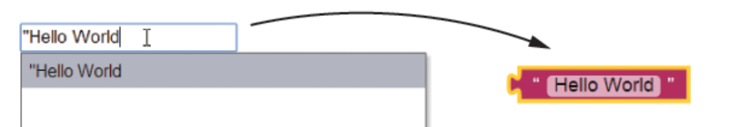
Examples

Slide 38
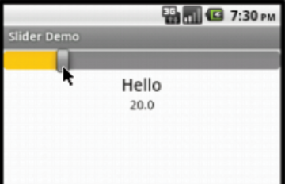
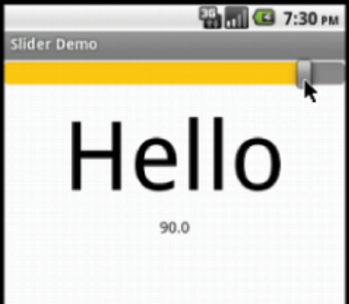
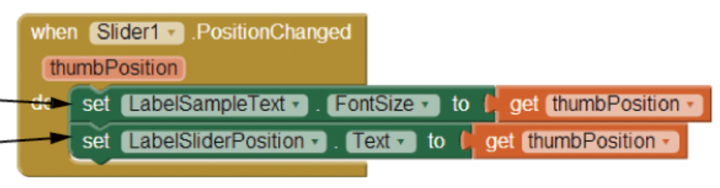
Slider Component

Slide 39
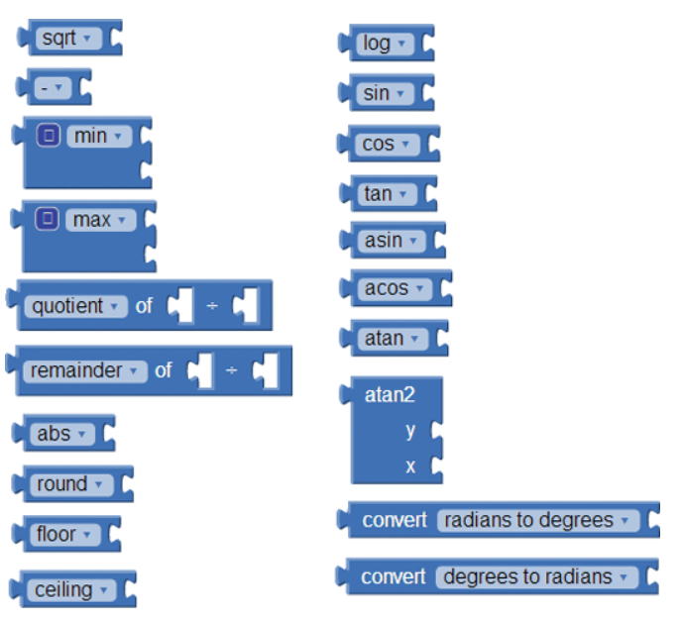
Math Functions

